Slide 1
Medical Exams Predictive Analytics Report out
Prepared for: Fargo Health Group
DS-700 Final Project
Spencer Swartz

Slide 2

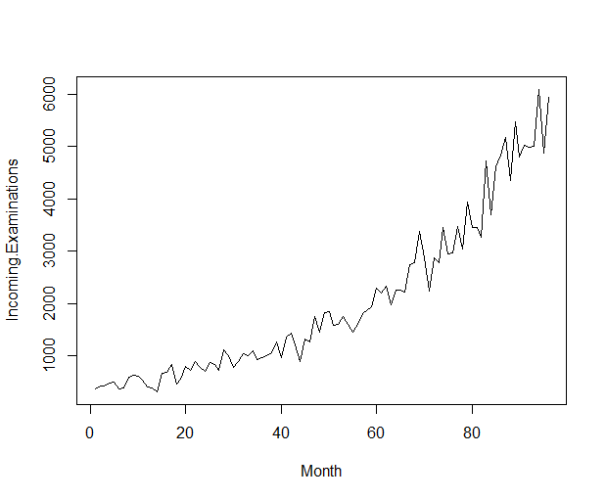
The Business Problem
Who: Fargo Health Group
What: A pilot study for predictive modeling
Why: Current Fargo staff are unable to complete all the work assigned.

Slide 3
Data Cleansing
The first step in cleaning this data was identifying all the records that are in question
Including:
Non-numbers
Outliers
Other data points noted as not correct
Incoming Examinations | Year | Month | Reason for Selection
* | 2006 | 3 | Data Entry
* | 2006 | 6 | Data Entry
99999999 | 2008 | 12 | Data Entry
Entered by J. f. Williams | 2009 | 5 | Data Entry
* | 2009 | 12 | Not Recorded
* | 2010 | 1 | Not Recorded
* | 2010 | 2 | Not Recorded
xx?*&?/.. | 2010 | 6 | Data Entry
999999999 | 2011 | 1 | Data Entry
Closed for Holidays | 2011 | 12 | Closed
* | 2013 | 12 | Rerouted
3110 | 2008 | 10 | Hurricane
107 | 2007 | 5 | Outlier, suspected Rerouted Exams were not included.
3110 | 2008 | 12 | Outlier, caused by a Hurricane closing a nearby center.
4730 | 2013 | 5 | Noted as incomplete, reroutes were not included.
4706 | 2013 | 6 | Noted as incomplete, reroutes were not included.
5000 | 2013 | 7 | Noted as incomplete, reroutes were not included.

Slide 4
Data Cleansing – Part I
The first record cleaned was Dec. 2013
Used “December 2013 Data” dataset
Broke out the column to represent the First 4 characters the last four as well as the condition code.
Filtered on relevant condition codes as well as first and last four.
Counted the records and replaced the record in the main data source
Incoming Examinations | Year | Month | Reason for Selection
* | 2013 | 12 | Rerouted
Original Column | First Four | Next3 | Condition Code | Last Four
L839ITSRLX001TGU3 | L839 | ITS | RLX001 | TGU3
L839SMARLX001TGU3 | L839 | SMA | RLX001 | TGU3
L839CRJRLX001TGU3 | L839 | CRJ | RLX001 | TGU3
L839BUARLX001TGU3 | L839 | BUA | RLX001 | TGU3

Slide 5
Data Cleansing – Part II
Next focus was on the 3 data points for Dec. 09 through Feb. 10
Calculated Avg. % of Total for the same three month in the years that we had the data.
Threw out 06-07 as the percentages returned were inconsistent
Computed values for 09-10 based on avg. % of Total
Incoming Examinations | Year | Month | Reason for Selection
* | 2009 | 12 | Not Recorded
* | 2010 | 1 | Not Recorded
* | 2010 | 2 | Not Recorded
Year | Dec | Jan | Feb
06-07 | 0.366964 | 0.355357 | 0.277679
07-08 | 0.289266 | 0.362619 | 0.348114
12-13 | 0.281019 | 0.350704 | 0.368277
09-10 computed | 0.285143 | 0.356661 | 0.358196
09-10 computed values | 1462 | 1829 | 1838

Slide 6
Data Cleansing – Part III
The records noted as incomplete as well as the May 07 record were next.
May 07 was identified as a possible outlier.
Used the May-2007 <Location> datasets to find missing data points
Summed all rows relevant to each month and added to the existing record on main data set.
Incoming Examinations | Year | Month | Reason for Selection
107 | 2007 | 5 | Outlier, suspected Rerouted Exams were not included.
4730 | 2013 | 5 | Noted as incomplete, reroutes were not included.
4706 | 2013 | 6 | Noted as incomplete, reroutes were not included.
5000 | 2013 | 7 | Noted as incomplete, reroutes were not included.

Slide 7
Data Cleansing - Part IV
The rest were cleaned with the same process
For the specific months in question the data was plotted and had an exponential trend line fitted
All trend lines had an R² of 0.9729 or higher
Except for May, this was because of the suspected outlier in 2007, one the new data was included the R² significantly rised.
All of the plots can be seen in the written report
Incoming Examinations | Year | Month | Reason for Selection
* | 2006 | 3 | Data Entry
* | 2006 | 6 | Data Entry
99999999 | 2008 | 12 | Data Entry
Entered by J. f. Williams | 2009 | 5 | Data Entry
* | 2009 | 12 | Not Recorded
* | 2010 | 1 | Not Recorded
* | 2010 | 2 | Not Recorded
xx?*&?/.. | 2010 | 6 | Data Entry
999999999 | 2011 | 1 | Data Entry
Closed for Holidays | 2011 | 12 | Closed
3110 | 2008 | 10 | Hurricane

Slide 8
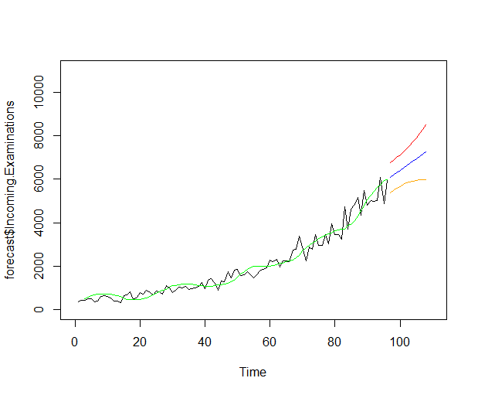
Creating Model One
Holt-Winters Exponential Smoothing model
Set model to account for a trend (gamma) and to not account for seasonality (beta)
Smoothing constant was set to 0.06
MAD=272.2
MAPE=18.5%
MSE=121,784.6

Slide 9
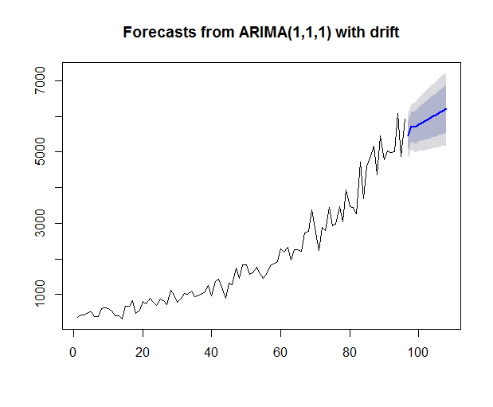
Creating Model Two
ARIMA model
Auto ARIMA model selected, R returned 1,1,1 for the variables
MAD=220.4
MAPE=15.6%
MSE=48,559

Slide 10
Which model is Recommended
Model one (Holt-Winters)
MAD= 272.2
MAPE=18.5%
MSE=121,784.6
Model two (ARIMA)
MAD=220.4
MAPE=15.6%
MSE=48,559
It is clear that the second model has the more impressive stats
What can be done to improve?
Gather more historic data
If the type exam being performed does not matter then including all exams may help the irregularity between months. Which in turn will help to improve the models.

